Slide 1
Database Management System (CS403)
VU
Lecture No. 11
Reading Material
“Database Systems Principles, Design and Implementation” written by Catherine Ricardo, Maxwell Macmillan.
Overview of Lecture
Inheritance
Super type
Subtypes
Constraints
Completeness
Disjointness
Subtype Discrimination
According to the Microsoft Dictionary of Computing
Inheritance Is
The transfer of the characteristics of a class in object-oriented programming to other
classes derived from it. For example, if “vegetable” is a class, the classes “legume” and
“root” can be derived from it, and each will inherit the properties of the “vegetable” class: name, growing season, and so on2. Transfer of certain properties such as open files, from a parent program or process to another program or process that the parent causes to run.
Inheritance in the paradigm of database systems we mean the transfer of properties of one entity to some derived entities, which have been derived from the same entities.
1
© Copyright Virtual University of Pakistan

Slide 2
Database Management System (CS403)
VU
Super types and Subtypes
Subtypes hold all the properties of their corresponding super-types. Means all those subtypes which are connected to a specific supertype will have all the properties of their supertype.
EmpName EmpAddress
EmpId
EMPLOYEE
EmpPhNo
Grade
NoOfHrs
SALARIED
HOURLY
AnnualSal
HourlyRate
Fig-1 a
The Figure:1 above shows that the supertype and subtype relation between the SALARIED and HOURLY employees with the supertype entity EMPLOYEE, we can see that the attributes which are specific to the subtype entities are not shown with the supertype entity. Only those attributes are shown on the supertype entity which are to be inherited to the subtypes and are common to all the subtype entities associated with this supertype.
The example shows that there is a major entity or entity supertype name EMPLOYEE and has a number of attributes. Now that in a certain organization there can be a number of employees being paid on different payment criteria.
2
© Copyright Virtual University of Pakistan

Slide 3
Database Management System (CS403)
VU
P_Name
P_Address
P_Id
PERSON
P_PhNo
C_Name
Qual
STD
FAC
CGPA
Grade
Fig – 1 b
The second example is that of student and the Faculty members who are at the super level same type of entities. Both the entities at the super level belong to the same entity of type Person. The distinct attributes of the student and faculty members are added later to he sub entities student and fac.
Supertype / subtype Relationship:
The use of supertype and subtype for the entities is very useful because it allows us to
create hierarchy of the entities according to the attributes they have and we need not to
write all the attributes again and again. We can group similar types of entities and the attributes associated with those entities at certain levels.
This also adds clarity to the definitions of the entities as it is not necessary to write the attribute again and again for all the entities.
Moreover it also eases the operation of removing or adding attributes from the entities, here it is worth noting that adding an attribute at the super entity level will add the
3
© Copyright Virtual University of Pakistan

Slide 4
Database Management System (CS403)
VU
attribute to the below listed or derived sub entities and removing the attribute will remove the attribute from the entities at sublevels in the same way.
The process of identifying supertype and creating different type of sub entities is supported by the general knowledge of the designer about the organization and also based of the attributes of the entities which are entities existing in the system..
Specifying Constraints
Once there has been established a super/sub entity relationship there are a number of constraints which can be specified for this relationship for specifying further restrictions on the relationship.
Completeness Constraint
There are two types of completeness constraints, partial completeness constraints and total completeness constraints.
Total Completeness:
Total Completeness constraint exist only if we have a super type and some subtypes
associated with that supertype, and the following situation exists between the super type and subtype.
All the instances of the supertype entity must be present in at one of the subtype entities,
i.e.—there should be not instance of the supertype entity which does not belong to any of the subtype entity.
This is a specific situation when the supertype entities are very carefully analyzed for their associated subtype entities and no sub type entity is ignored when deriving sub entities from the supertype entity.
Partial Completeness Constraint:
This type of completeness constraint exists when it is not necessary for any supertype
entity to have its entire instance set to be associated with any of the subtype entity.
4
© Copyright Virtual University of Pakistan

Slide 5
Database Management System (CS403)
VU
This type of situation exists when we do not identify all subtype entities associated with a supertype entity, or ignore any subtype entity due to less importance of least usage in a specific scenario.
Disjointness Constraint
This rule or constraint defines the existence of a supertype entity in a subtype entity. There exist type types of disjoint rules.
Disjointness rule
Overlap rule
Disjoint constraint:
This constraint restricts the existence of one instance of any supertype entity to exactly
one instance of any of the subtype entities.
Considering the example given in Fig 1a it is seen that there can be two types of employees, one which are fixed salary employees and the others are hourly paid employees. Now the disjoint rule tells that at a certain type an employee will be either hourly paid employee or salaried employee, he can not be placed in both the categories in parallel.
Overlap Rule:
This rule is in contrast with the disjoint rule, and tells that for one instance of any
supertype entity there can be multiple instances existences of the of the instance for more then one subtype entities. Again taking the same example of the employee in an organization we can say that one employee who is working in an organization can be allowed to work for the company at hourly rates also once he has completed his duty as a salaried employee. In such a situation the employee instance record for this employee will be stored in both the sub entity types.
5
© Copyright Virtual University of Pakistan

Slide 6
Database Management System (CS403)
VU
P_Name
AdmDate
Ph_Id
P_Id
PATIENT
RESPONSIBLE PHYSICIAN
Prescription
WardNo
OUT DOOR PATIENT
IN DOOR PATIENT
DateDischarge
Fig 2-a
In the example the completeness of the relation is shown between the supertype entity and the subtype entity, it shows that for the data of patients we can have only two type of patients and one patient can be either an outdoor patient or indoor patient. In it we can see that we have identified all possible subtypes of the supertype patient. This implies a completeness constraint. One more thing to note here is the linked entity physician to the patient entity. And all the relationships associated with the supertype entity are inherited to subtype entities of the concerned supertype.
6
© Copyright Virtual University of Pakistan

Slide 7
Database Management System (CS403)
VU
Veh_Id
Model
Price
VEHICLE
Registration
NoOfDoors
CAR
TRUCK
Pessengers
Fig 2-b
The Figure2b shows the supertype and subtype relationship among different type of
vehicles. Here we can see that the Vehicle has only two subtypes, known as Truck and Car, As it is normal to have a number of other vehicles in the company of a certain type but when we have noted just a limited number of vehicles then it means that we are not interested in storing information for all the vehicles as separate entities. They may be stored in the vehicle entity type itself and distinct vehicle may be stored in the subtypes car and truck of the Vehicle.
This is a scenario where we have the freedom to store several entities and neglect others, and it is called as partial completeness constraint rule.
After the discussion of the Total Completeness and Partial completeness let us move to the next constraint that is disjointness and check for its examples.
Again in the Figure 2-a. we have the environment where patient entity type has two subtypes indoor and outdoor patient. To represent disjointness we place the letter “D” in the circle which is splitting the super entity type into two sub entity types. Suppose that the hospital has placed a restriction on the patient to be either a n indoor patient or
7
© Copyright Virtual University of Pakistan

Slide 8
Database Management System (CS403)
VU
outdoor patient, in such a case there exists disjointness which specifies that the patients data can not be place in the database in both the subtype entities. It will be wither indoor or outdoor.
Part_No PartName
PART
O
Sup_Id
MANUFAC- TURED
PURCHASED
PURCHASED
Sup_address
Fig- 3
The figure 3 above shows the second type of disjoint constraint which tells that the entity
subtype instance can be repeated for any single entity supertype instance. We can see the relationship of a certain hardware company for the parts provided by the company to its clients. Now there may exist an overlapping situation for a certain part which is to be provided to a certain firm, but the manufactured quantity of that part is not enough to meet the specific order, In this situation the company purchases the remaining the deficient number of parts form the other suppliers. We can easily say that the data for that specific part is to be placed in both the entity subtypes. Because it belongs to both the subtype entities, this is an overlapping situation and expresses disjointness with overlapping. Another important thing which is to be noted here that the purchased part subtype entity has a relationship with another entity where the data for the suppliers is stored from whom the parts are bought. Now this relation does not have nay interaction with the manufactured parts relation as it is not connected with its supertype i.e.—parts supertype entity.
8
© Copyright Virtual University of Pakistan

Slide 9
Database Management System (CS403)
VU
Considering the above discussed we can have four different types of combination existing for the supertype and subtype entities.
Complete Disjoint
Complete Overlapping
Partial Disjoint
Partial overlapping
Subtype Discriminator
This is a tool or a technique which provides us a methodology to determine that to which subtype one instance of a supertype belongs.
To determine the relation we place an attribute in the entity supertype which can specify through its value, that to which entity subtype it belongs.
For example we consider the example
There can be two different situations which specify the placement or relationship of a supertype entity instance in a subtype entity instance. First situation is that of disjoint situation where one supertype entity instance can be placed only in one subtype of that supertype. Let us consider the example of vehicles above in Figure-2-b it show that there can be two different vehicles car and truck associated with the supertype vehicle now if we place an attribute named Vehicle_type in the supertype we can easily determine the type of the associated subtype by placing a C for car and a T for truck instance of the vehicle.
The other situation where the Subtype discriminator is required the overlapping constraint; it is the situation where one supertype attribute can be placed in more than one subtype entities.
Considering again the part example shown in Figure 3, which has an overlapping
constraint; In this situation we can have many solution one common solution is to place two attribute in the supertype one for manufactured and other one for purchased. We can combine them as a composite attribute, when we place Y for manufacture and N for
9
© Copyright Virtual University of Pakistan

Slide 10
Database Management System (CS403)
VU
Purchased then it means the part is manufactured by the company, and similarly the following situation will give us further information
Attribute
Manufacture | Purchased | Result
Y | Y | Manufacture Purchased
Y | N | Manufactured
N | Y | Purchased.
Significance of Subtype Discriminator:
Existence of subtype discriminator helps us a lot in finding the corresponding subtype entities, although we can find a subtype entity instance without having a subtype discriminator in the supertype but that involves lots of efforts and might consume a huge time in worst case situations.
This concludes out discussion of The ER Model in the course.
10
© Copyright Virtual University of Pakistan

Slide 11
Database Management System (CS403)
VU
Lecture No. 12
Reading Material
“Database Systems Principles, Design and Implementation” written by Catherine Ricardo, Maxwell Macmillan.
Overview of Lecture
In today’s lecture we will discuss the ER Data model for an existing system and will go through a practice session for the logical design of the system
The system discusses is an examination section of an educational institute with the implementation of semester system.
Steps in the Study of system
Preliminary study of the system
Students are enrolled in programs.
The programs are based on courses
Different courses are offered at the start of the semester
Students enroll themselves for these courses at the start of semesters
Enrolled courses by students and offered courses must not be same.
The difference is due to the individual situation of every student, because if one student has not pass a certain course ‘A’ in the previous semester he will not be able to register for a course ‘B’ offered in this semester as the course ‘A’ is the prerequisite for course ‘B’.
After valid registration classes start.
A Course which is offered is assigned to a teacher also
There can be any mid term exams and in this system we have only one mid term
All the students are given assignments and quizzes and are awarded marks against their performance.
Result of the student is prepared on the basis of assignment marks, sessional and mid term marks and the final exam.
GP (Grade point) for students is calculated in each subject.
Average grade point is calculated on the basis of GPs in individual subjects
11
© Copyright Virtual University of Pakistan

Slide 12
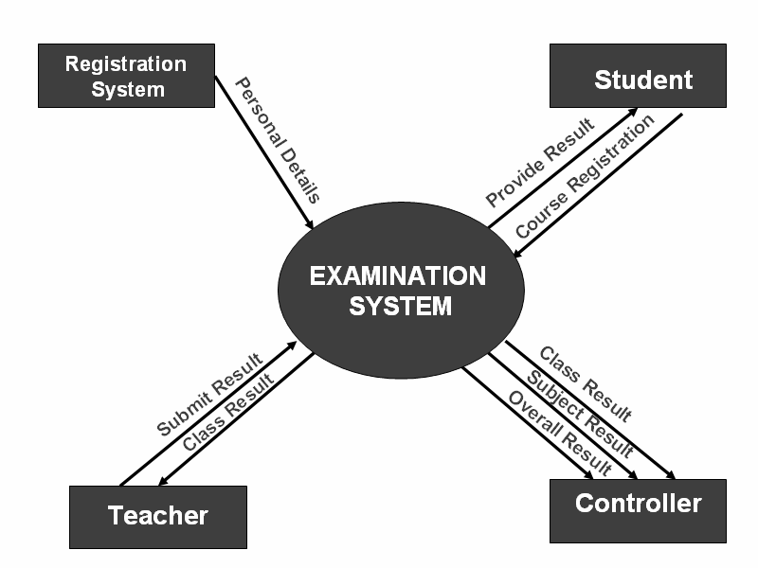
Database Management System (CS403)
VU
And the Cumulative GPA is calculated for all the passed semesters.
Outputs Required
Teachers and controller need class list or attendance sheet, class result; subject and overall
Students need transcripts, semester result card, subject result
Entities associated with the system
Students
Teachers
Controllers
Once the analysis of the system is done it is important to make a draft of the system using a standard tool which specifies the component and design of the system. This design is useful because anyone using the design can work on the existing system and clearly understand the working without working on the system from the scratch.
Tool used for such graphical design is Data Flow Diagram (DFD)
In the Figure -1 of the system we have a context diagram of the system which shows integration of different entities with the examination system, these include Registration system, controller, student and teacher entities.
Fig-1
o From the diagram we can understand basic functionality of the system and can find how the data is flowing in the system and how different external entities are communicating or interacting with the system.
12
© Copyright Virtual University of Pakistan

Slide 13
Database Management System (CS403)
VU
First of all we have registration system, which provides the data of students to the systems once the registration process has been completed, this data is now free of errors in terms of validity of a certain student for a certain course or a semester.
Second external entity interacting with the system is the teacher, a Teacher is given a list of students who are enrolled in a class and the registration system has declared them as valid students for that very course. Then the teacher allows those students in the class and continues the process of teaching the class, during this process the teacher takes test of the students and prepares papers for the students and also prepares quizzes to be submitted by students. All the data of students’ attendance quizzes and assignments along-with different sessional results is then submitted by the teacher to the examination system which is responsible for preparation of results of the students
Third interacting entity with the system is the controller’s office it is provided with the semester overall result, subject results and also the result of each class fir performance evaluation and many other aspects.
Fourth entity is student which externally interacts with the system for getting its result, the result is submitted to the student and may be in one of different forms such as, transcript and result card etc.
Level 0 Diagram
The three major modules which have been identified are given below our level 0 diagram will be based on these three modules and will elaborate and describe each of the modules in details.
Subject registration
Result submission
Result calculation
13
© Copyright Virtual University of Pakistan

Slide 14
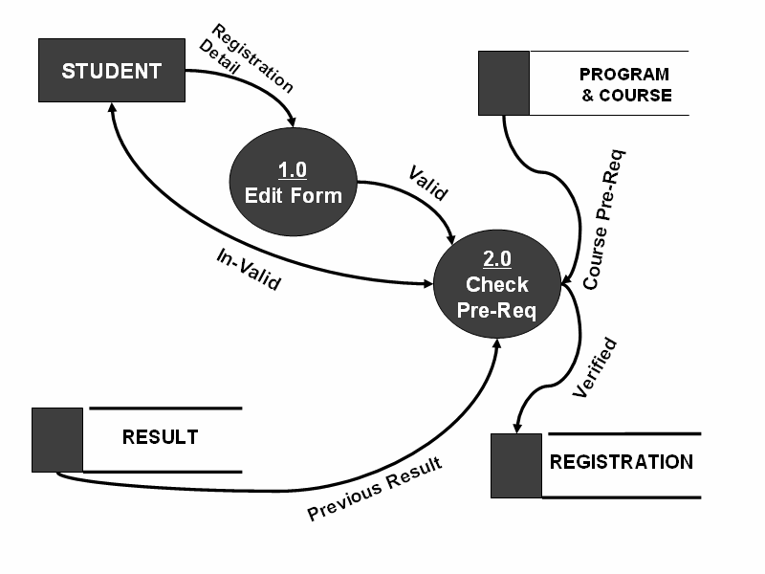
Database Management System (CS403)
VU
Fig 2
The first module identified in the system is the Registration of the students for the system As the DFD show a student applies for registration along-with certain registration information which is required by the system, Process 1.0 of the system checks the validity of information in the form if the Registration form is found to be valid the information in the form is passed onto the second process where the validity of registration is determined by checking certain prerequisites for the courses to which student wishes to be enrolled. After the prerequisite checking the data of the student is stored in a registration database for use by other processes in the system.
During this process the result of the students is also checked for the previous semester or previously studied subject to confirm whether the student has passed a certain pre- requisite subject before he can attempt to enroll for a second course which is based on that prerequisite.
14
© Copyright Virtual University of Pakistan

Slide 15
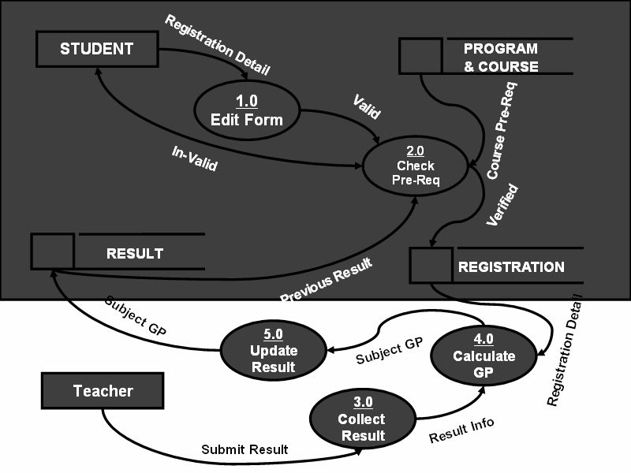
Database Management System (CS403)
VU
Fig-3
The Second DFD is in fact combination of the last diagram and some new details to the DFD this portion adds the result submission to the whole process of the system The teacher is the external entity here which is submitting the result, the result collection process is numbered 3.0, result is submitted by the teacher in parts, i.e. –separately for assignments, quizzes, tests, sessional and final result. The Collection process then forward the collected result to the Calculate GP Process, this process calculates the Grade point for the subject, the result with GP calculated is then moved forward to the update result process which then makes a change in the result data store by updating the result data for that specific student.
15
© Copyright Virtual University of Pakistan

Slide 16
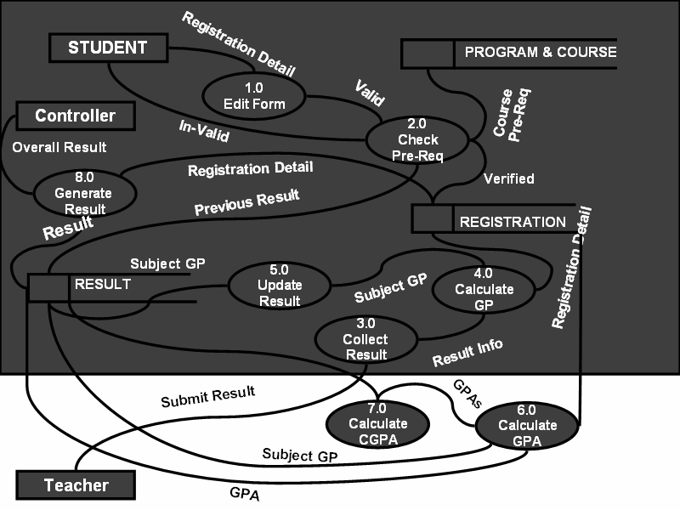
Database Management System (CS403)
VU
Fig-4
After the process of result submission the result for all the subjects is taken and the GPA is calculated, once the GPA is calculated the it is used for further calculation of CGPA and is forwarded to another process which is numbered 7.0 this process will calculate the CGPA by taking all the results of the current and previous semesters.
Further detailed diagram i.e.—Detailed DFD can be created using the given level 0 DFD and by expanding all the Processes further.
Cross Reference Matrix: doth:
This matrix is used to find out that what values or attributes will appear in which reports,
for this purpose we write the major item names on a matrix in the row wise order and the reports which will be generated will be written on top or in column wise order.
16
© Copyright Virtual University of Pakistan

Slide 17
Database Management System (CS403)
VU
Cross Reference Matrix
 | Transcript | Semester Result Card | Attendance Sheet | Class Result (Subject Wise) | Class Result
Course_Name | ✓ | ✓ |  | ✓
CGPA | ✓ | ✓ |  |  | ✓
Date | ✓ | ✓ |  | ✓ | ✓
F_Name | ✓ | ✓
NameOfStudent |  | ✓
NameOfProgram |  | ✓
Reg_No | ✓ | ✓ | ✓ | ✓ | ✓
This process infact is just cross link So the first Item transcript which may be or it will be needed by a specific student, second is Result card, next is attendance sheet then we have Class result (Subject wise) and finally the Class result as a whole, here by subject wise class result means that all the results of a specific class for a specific student considering each component, such as assignments, quizzes, sessional and terminal results.
Similarly all the mentioned items are marked with a tick which may needed by a certain output.
Let us see how the DFD and CRM are used in creating the ER-Diagram
The process of Creating ER-Diagram in fact lies in the Analysis phase and is started with identifying different entities which are present in the system. For this purpose we can use the DFD first of all.
Lets check our DFD, from there we can find the following entities.
17
© Copyright Virtual University of Pakistan

Slide 18
Database Management System (CS403)
VU
Student Courses
Courses Offered Registration Semester
Controller Teachers
Programs Results
Here the point to be noted is that, we have picked the controller as the entity, although the controller is acting as an external entity for providing or getting information from the system, but in case of ER-Diagram the controller can not be represented as an
entity because there is only one controller in any examination system and for such an entity instances a complete entity is not used.
So in this way we can exclude the controller entity, we will also take care of other entities before including them in our ED-Diagram. Another such example is results, which may not be as it is, added to the ER-Diagram, because there can be a number of result types at different stages of the Process, so there will be a number of different results.
We use our CRM in creating the ER-Diagram, because when we see the CRM, it has
a number of item/attributes appearing on it, now from there we can see that whether these items belong to the same entity or more than one entity. And even if they belong to multiple entities we can find the relationship existing between those entities.
Considering our CRM we have transcript, it has a number of items appearing on it , as
we know that there is to appear result for each semester on the transcript. So the attributes which belong to the personal information of the student shall be placed in the student entity and the data which belongs to the students’ academic data will be placed in the courses or results entity for that student.
In the next phase we have to draw different entity type and the relationship which exist between those entities.
These we will discuss in the next lecture that how we draw relationships between different entities.

Slide 19
Database Management System (CS403)
VU
Lecture No. 13
Reading Material
Case Study
Overview of Lecture
E – R Diagram of Examination System
Conceptual Data Base Design
Relationships and Cardinalities between the entities
In the previous lecture we discussed the Preliminary phase of the Examination system. We discussed the outputs required from the system and then we drew the data flow diagrams DFDs. From this lecture we will start the conceptual model of the system through E-R Diagram.
Identification of Entity Types of the Examination System
We had carried out a detailed preliminary study of the system, also drawn the data flow diagrams and then identified major entity types. Now we will identify the major attributes of the identities, then we will draw the relationships and cardinalities in between them and finally draw a complete E-R Diagram of the system.. So first of all we will see different attributes of the entities.
Program:
This entity means that what different courses are being offered by an institute, like MCS, BCS etc. Following are the major attributes of this entity:-
pr_Code. It can be used as a primary key of the entity as it would always be unique for example MBA, MCS, etc.
max_Dur It means that what is the maximum duration of any particular course , like 1 year , 2 years and so on.
no_of_Semesters How many semesters this program has like four ,six and so
on.
Pr_Lvl This course is of undergraduate, graduate or post graduate level.
Student:

Slide 20
Database Management System (CS403)
VU
Following are the major attributes of this entity:-
Reg_No This can be used as a primary key for this entity as it will be unique for every student.
st_Name This would be the first name of all the students of an institute.
St_Father_name This would represent the father’s name of a student.
St_date_of_Birth. The date of birth of all students including year , month and day.
st_Phone_no
st_GPA This is a very important attribute. Now to know the GPA of any student, we need to know the student reg no and the particular semester. So
this is a multi valued attribute as to know the GPA, different attributes values are required. So this represented by a relation, which will be discussed in the relationships in between entities.
st_Subj_Detail This is also a multi valued attribute ,as to know the marks in mid terms and final papers , student reg no and the particular subject are required
Teacher:
Following are the major attributes of this entity: -
teacher_Reg_No This can be used as a primary key for this entity as it will be unique for every teacher.
teacher_Name This would be the first name of all the teachers of an institute.
teacher_Father_name This would represent the father’s name of a teacher.
Qual. The qualification of a teacher like Masters or Doctorate.
Experience This can also be a multi-valued attribute or a single valued attribute. If only total experience of any teacher is required then it can be single valued, but if details are required as per the different appointments, then in that case it would be multi valued.
teacher_Sal The total salary of the teacher.
There is one thing common in between teacher and student an entity that is the personal details of both, like name, father’s name and addresses.
Course:
Following are the major attributes of this entity: -
course_Code This can be used as a primary key for this entity as it will be unique for every course like CS-3207.
course_Name
course_Prereq This would also be a multi valued attribute as there can be a
multiple requisites of any course . For example, Networking can have pre- requisites of Operating System and Data Structures. In this case this is a

Slide 21
Database Management System (CS403)
VU
recursive relation as pre-requisite of a course is a course. We will treat it as a recursive relation here.
o Courses_Offered_in This is also a multi valued attribute as to know the
courses offered , program and semester both are required so this can also be represented by a relation
Semester:
Following are the major attributes of this entity: -
semester_Name This can be used as a primary key for this entity as it will be unique for every semester like fall 2003 or spring 2004.
semester_Start_Date The starting date of the semester
semester_End_Date The ending date of the semester
Derived Attributes
There are certain attributes in the examination system which is derived like CGPA of a student can only be achieved from the semesters GPA. Similarly FPA of any
particular semester can be achieved from subjects GPA of the semester. So this has to be kept in mind while drawing the E-R Diagram of the system.
Relationships and Cardinalities in between Entities
Relationships and cardinalities in between entities is very important. We will now see the relationship of different entities one by one. The block diagrams of different entities are as under: -
PROGRAM
COURSES
STUDENT
CRS_OFFERED
SEMESTER
TEACHER

Slide 22
Database Management System (CS403)
VU
Program and Courses
The relationship between program and courses is that, if we want to know the courses in any particular program then the course codes and program codes are required. The cardinality between program and courses is of one to many (1 -*) , which means that any program will have minimum one course, and as many as required for that particular program. The cardinality of courses and program can be zero to many (0
- *). It means that if an institution wants, it can have a course without even any program as well. This course can be included in any program later on.
1 - *
PROGRAM
COURSES
0 - *
Students and Programs
The cardinality in between student and program is one, which means that every student can have minimum and maximum one program at any time. The cardinality in
between programs and students can be zero to many (0 - *), which means that depending upon the requirements of any organization it can have a program which is presently not being offered to any students.
STUDENTS
1
PROGRAM
0 - *
Semester and Course
The relationship in between semester and course is many to many. But it is essential to know the course offered during any particular semester so there is a requirement of an attribute, which is of relationship and when it is many to many it, can also serve as entity which is represented by a diamond in a rectangle. So here this can be a courses offered attribute, which would also be an entity. The primary key of semester that is semester code and primary key of course that is course code, after combining it becomes composite key which would be used to identify any particular course.
Course Offered and Teacher
There is a relationship in between course offered and teacher. The cardinality of course offered and teacher is one that is a teacher can only have one course at a time. Similarly the cardinality in between teacher and course offered is one to many, which means that a teacher can teach many courses.

Slide 23
Database Management System (CS403)
VU
Student and Course Offered
The relationship in between student and course offered is many to many so this relationship is also through enrolled attribute, which can also serve as entity type. The
primary keys of semester, course and student are used as composite key to identify, that which student has got which course.
Semester and Student
To find out GPA of any student the semester is also required to be known. So the relationship in between these two can be through result whose attribute GPA can be used. There is a many to many relationship in these two entities.
1 - *
COURSE OFFERED
1 - *
TEACHER
SEMESTER
0 - *
1 - *
1
GPA
ENROLLED
1 - *
STUDENT
Conceptual Database Design
The outcome of analysis phase is the conceptual database design, which is drawn through E-R model. This design is independent of any tool or data model. This design can be implemented in multiple data models like network, relational or hierarchal models.
Logical Database Design
This is the next phase of database design, in which appropriate data model is chosen, and from here onwards it becomes tool dependent. We will select relational data model and our further lectures will be concerning relational data models

Slide 24
Database Management System (CS403)
VU
Conclusion
The E – R Model of Examination system of an educational institute discussed above is just a guideline. There can certainly be changes in this model depending upon the requirements of the organization and the outputs required. After drawing an E-R model, all the outputs, which are required, must be matched with the system. If it does not fulfill all the requirements then whole process must be rehashed once again. All necessary modifications and changes must be made before going ahead. For Example, if in this system attendance sheet of the students is required then program code, semester and course codes are required, this composite key will give the desired attendance sheet of the students.

Slide 25
Database Management System (CS403)
VU
Lecture No. 14
Reading Material
“Database Systems Principles, Design and Implementation” written by Catherine Ricardo, Maxwell Macmillan. | Section 6.1 – 6.3.3
“Database Management Systems”, 2nd edition, Raghu Ramakrishnan, Johannes Gehrke, McGraw-Hill
Overview of Lecture
Logical Database Design
Introduction to Relational Data Model
Basic properties of a table
Mathematical and database relations
From this lecture we are going to discuss the logical database design phase of database development process. Logical database design, like conceptual database design is our database design; it represents the structure of data that we need to store to fulfill the requirements of the users or organization for which we are developing the system. However there are certain differences between the two that are presented in the table below:
 | Conceptual Database Design | Logical Database Design
1 | Developed in a semantic data model (generally E-R data model) | In legacy data models (relational generally in current age)
2 | Free of data model in which going to be implemented; many/any possible | Free of particular DBMS in which going to be implemented; many/any possible
3 | Results from Analysis Phase | Obtained by translating the conceptual database design into another data model

Slide 26
Database Management System (CS403)
VU
4 | Represented graphically | Descriptive
5 | More expressive | Relatively less expressive
6 | Going to be transformed and then implemented | Going to be implemented
You can think more, give a try
Table 1: Differences between Conceptual and Logical Database Designs
As we have already discussed in previous lectures and as is given in row 2 of the above table, the conceptual database design can be transformed into any data model, like, hierarchical, network, relational or object-oriented. So the study of the logical database design requires first involves the study of the data model/(s) that we can possibly use for the purpose. However, in the current age, since early eighties, the most popular choice for the logical database design is the relational data model; so much popular that today it can be considered to be the only choice. Why? Because of its features we are going to discuss in today’s lecture. That is why rather than studying different data models we will be studying only the relational data model. Once we study this, the development of logical database design is transformation of conceptual database design to relational one and the process is very simple and straightforward. So from today’s lecture our discussion starts on the relational data model. Just for the sake of revision we repeat the definition of data model “a set of constructs/tools used to develop a database design; generally consists of three components which are constructs, manipulation language and integrity constraints”. We have discussed it earlier that the later part of the definition (three components) fits precisely with the relational data model (RDM), that is, it has these components defined clearly.
Relational Data Model
The RDM is popular due to its two major strengths and they are:
Simplicity
Strong Mathematical Foundation
The RDM is simple, why, there is just one structure and that is a relation or a table. Even this single structure is very easy to understand, so a user of even of a moderate

Slide 27
Database Management System (CS403)
VU
genius can understand it easily. Secondly, it has a strong mathematical foundation that gives many advantages, like:
Anything included/defined in RDM has got a precise meaning since it is based on mathematics, so there is no confusion.
If we want to test something regarding RDM we can test it mathematically, if it works mathematically it will work with RDM (apart from some exceptions).
The mathematics not only provided the RDM the structure (relation) but also well defined manipulation languages (relational algebra and relational calculus).
It provided RDM certain boundaries, so any modification or addition we want to make in RDM, we have to see if it complies with the relational mathematics or not. We cannot afford to cross these boundaries since we will be losing the huge advantages provided by the mathematical backup.
“An IBM scientist E.F. Codd proposed the relational data model in 1970. At that time most database systems were based on one of two older data models (the
hierarchical model and the network model); the relational model revolutionized the database field and largely replaced these earlier models. Prototype relational database management systems were developed in pioneering research projects at IBM and UC-Berkeley by the mid-70s, and several vendors were offering relational database products shortly thereafter. Today, the relational model is by far the dominant data model and is the foundation for the leading DBMS products, including IBM's DB2 family, Informix, Oracle, Sybase, Microsoft's Access and SQLServer, FoxBase, and Paradox. Relational database systems are ubiquitous in the marketplace and represent a multibillion dollar industry” [1]
The RDM is mainly used for designing/defining external and conceptual schemas; however to some extent physical schema is also specified in it. Separation of conceptual and physical levels makes data and schema manipulation much easier, contrary to previous data models. So the relational data model also truly supports “Three Level Schema Architecture”.
Introduction to the Relational Data model
The RDM is based on a single structure and that is a relation. Speaking in terms of the
E-R data model, both the entity types and relationships are represented using relations

Slide 28
Database Management System (CS403)
VU
in RDM. The relation in RDM is similar to the mathematical relation however database relation is also represented in a two dimensional structure called table. A table consists of rows and columns. Rows of a table are also called tuples. A row or tuple of a table represents a record or an entity instance, where as the columns of the table represent the properties or attributes.
stID | stName | clName | doB | sex
S001 | M. Suhail | MCS | 12/6/84 | M
S002 | M. Shahid | BCS | 3/9/86 | M
S003 | Naila S. | MCS | 7/8/85 | F
S004 | Rubab A. | MBA | 23/4/86 | F
S005 | Ehsan M. | BBA | 22/7/88 | M
Table 2: A database relation represented in the form of a table
In the above diagram, a table is shown that consists of five rows and five columns. The top most rows contain the names of the columns or attributes whereas the rows represent the records or entity instances. There are six basic properties of the database relations which are:
Each cell of a table contains atomic/single value
A cell is the intersection of a row and a column, so it represents a value of an
attribute in a particular row. The property means that the value stored in a single cell is considered as a single value. In real life we see many situations when a property/attribute of any entity contains multiple values, like, degrees that a person has, hobbies of a student, the cars owned by a person, the jobs of an employee. All these attributes have multiple values; these values cannot be placed as the value of a single attribute or in a cell of the table. It does not mean that the RDM cannot handle such situations, however, there are some special means that we have to adopt in these situations, and they can not be placed as the value of an attribute because an attribute can contain only a single value. The values of attributes shown in table 1 are all atomic or single.

Slide 29
Database Management System (CS403)
VU
Each column has a distinct name; the name of the attribute it represents
Each column has a heading that is basically the name of the attribute that the column represents. It has to be unique, that is, a table cannot have duplicated column/attribute names. In the table 2 above, the bold items in the first row represent the column/attribute names.
The values of the attributes come from the same domain
Each attribute is assigned a domain along with the name when it is defined. The domain represents the set of possible values that an attribute can have. Once the domain has been assigned to an attribute, then all the rows that are added into the table will have the values from the same domain for that particular column. For example, in the table 2 shown above the attribute doB (date of birth) is assigned the domain “Date”, now all the rows have the date value against the attribute doB. This attribute cannot have a text or numeric value.
The order of the columns is immaterial
If the order of the columns in a table is changed, the table still remains the same. Order of the columns does not matter.
The order of the rows is immaterial
As with the columns, if rows’ order is changed the table remains the same.
Each row/tuple/record is distinct, no two rows can be same
Two rows of a table cannot be same. The value of even a single attribute has to be different that makes the entire row distinct.
There are three components of the RDM, which are, construct (relation), manipulation language (SQL) and integrity constraints (two). We have discussed the relation so far; the last two components will be discussed later. In the next section we are going to

Slide 30
Database Management System (CS403)
VU
discuss the mathematical relations briefly that will help to link the mathematical relations with the database relations and will help in a better understanding of the later.
Mathematical Relations
Consider two sets
A = {x, y} B = {2, 4, 6}
Cartesian product of these sets (A x B) is a set that consists of ordered pairs where
first element of the ordered pair belongs to set A where as second element belongs to set B, as shown below:
A X B= {(x,2), (x,4), (x,6), (y,2), (y,4), (y,6)}
A relation is some subset of this Cartesian product, For example,
• R1= {(x,2), (y,2),(x,6),(x,4)}
• R2 = {(x,4), (y,6), (y,4)}
The same notion of Cartesian product and relations can be applied to more than two sets, e.g. in case of three sets, we will have a relation of ordered triplets
Applying the same concept in a real world scenario, consider two sets Name and Age having the elements:
Name = {Ali, Sana, Ahmed, Sara}
• Age = {15,16,17,18,…….,25}
Cartesian product of Name & Age
Name X Age= {(Ali,15), (Sana,15), (Ahmed,15), (Sara,15), …., (Ahmed,25), (Sara,25)}
Now consider a subset CLASS of this Cartesian product
CLASS = {(Ali, 18), (Sana, 17), (Ali, 20), (Ahmed, 19)}
This subset CLASS is a relation mathematically, however, it may represent a class in
the real world where each ordered pair represents a particular student mentioning the name and age of a student. In the database context each ordered pair represents a tuple and elements in the ordered pairs represent values of the attributes. Think in this way, if Name and Age represent all possible values for names and ages of students, then any class you consider that will definitely be a subset of the Cartesian product of the Name and Age. That is, the name and age combination of all the students of any class

Slide 31
Database Management System (CS403)
VU
will be included in the Cartesian product and if we take out particulars ordered pairs that are related to a class then that will be a subset of the Cartesian product, a relation.
Database Relations
Let A1, A2, A3, …, An be some attributes and D1, D2, D3,…, Dn be their domains A relation scheme relates certain attributes with their domain in context of a relation. A relation scheme can be represented as:
R = (A1:D1, A2:D2, ……, An:Dn), for example,
STD Scheme = (stId:Text, stName: Text, stAdres:Text, doB:Date) OR STD(stId, stName, stAdres, doB)
Whereas the stId, stName, stAdres and doB are the attribute names and Text, Text, Text and Date are their respective domains. A database relation as per this relation scheme can be:
STD={(stId:S001, stName:Ali, stAdres: Lahore, doB:12/12/76), (stId:S003, stName:A. Rehman, stAdres: RWP, doB:2/12/77)} OR
STD={(S001, Ali, Lahore, 12/12/76), (S003, A. Rehman, RWP, 2/12/77)}
The above relation if represented in a two dimensional structure will be called a table as is shown below:
stId | stName | stAdres | doB
S001 | Ali | Lahore | 12/12/76
S002 | A. Rehman | RWP | 2/12/77
With this, today’s lecture is finished; the discussion on RDM will be continued in the next lecture.
Summary
In this lecture we have started the discussion on the logical database design that we
develop from the conceptual database design. The later is generally developed using
E-R data model, whereas for the former RDM is used. RDM is based on the theory of mathematical relations; a mathematical relation is subset of the Cartesian product of two or more sets. Relations are physically represented in the form of two-dimensional

Slide 32
Database Management System (CS403)
VU
structure called table, where rows/tuples represent records and columns represent the attributes.
Exercise:
Define different attributes (assigning name and domain to each) for an entity
STUDENT, then apply the concept of Cartesian product on the domains of these
attributes, then consider the records of your class fellows and see if it is the subset of the Cartesian product.

Slide 33
Database Management System (CS403)
VU
Lecture No. 15
Reading Material
Overview of Lecture
Database and Math Relations
Degree and Cardinality of Relation
Integrity Constraints
Transforming conceptual database design into logical database design
Composite and multi-valued Attributes
Identifier Dependency
In the previous lecture we discussed relational data model, its components and properties of a table. We also discussed mathematical and database relations. Now we will discuss the difference in between database and mathematical relations.
Database and Math Relations
We studied six basic properties of tables or database relations. If we compare these
properties with those of mathematical relations then we find out that properties of both are the same except the one related to order of the columns. The order of columns in mathematical relations does matter, whereas in database relations it does not matter. There will not be any change in either math or database relations if we change the rows or tuples of any relation. It means that the only difference in between these two is of order of columns or attributes. A math relation is a Cartesian product of two sets. So if we change the order of theses two sets then the outcome of both will not be same. Therefore, the math relation changes by changing the order of columns. For Example , if there is a set A and a set B if we take Cartesian product of A and B then we take Cartesian product of B and A they will not be equal , so
A x B = B x A
Rests of the properties between them are same.

Slide 34
Database Management System (CS403)
VU
Degree of a Relation
We will now discuss the degree of a relation not to be confused with the degree of a
relationship. You would be definitely remembering that the relationship is a link or
association between one or more entity types and we discussed it in E-R data model. However the degree of a relation is the number of columns in that relation. For Example consider the table given below:
STUDENT
StID | stName | clName | Sex
S001 | Suhail | MCS | M
S002 | Shahid | BCS | M
S003 | Naila | MCS | F
S004 | Rubab | MBA | F
S005 | Ehsan | BBA | M
Table 1: The STUDENT table
Now in this example the relation STUDENT has four columns, so this relation has degree four.
Cardinality of a Relation
The number of rows present in a relation is called as cardinality of that relation. For example, in STUDENT table above, the number of rows is five, so the cardinality of the relation is five.
Relation Keys
The concept of key and all different types of keys is applicable to relations as well. We will now discuss the concept of foreign key in detail, which will be used quite frequently in the RDM.
Foreign Key
An attribute of a table B that is primary key in another table A is called as foreign key. For Example, consider the following two tables EMP and DEPT:
EMP (empId, empName, qual, depId) DEPT (depId, depName, numEmp)
In this example there are two relations; EMP is having record of employees, whereas DEPT is having record of different departments of an organization. Now in EMP the primary key is empId, whereas in DEPT the primary key is depId. The depId which is primary key of DEPT is also present in EMP so this is a foreign key.
Requirements/Constraints of Foreign Key
Following are some requirements / constraints of foreign key:
There can be more than zero, one or multiple foreign keys in a table, depending on how many tables a particular table is related with. For example in the above example the EMP table is related with the DEPT table, so there is one foreign key depId,

Slide 35
Database Management System (CS403)
VU
whereas DEPT table does not contain any foreign key. Similarly, the EMP table may also be linked with DESIG table storing designations, in that case EMP will have another foreign key and alike.
The foreign key attribute, which is present as a primary key in another relation is called as home relation of foreign key attribute, so in EMP table the depId is foreign
key and its home relation is DEPT.
The foreign key attribute and the one present in another relation as primary key can have different names, but both must have same domains. In DEPT, EMP example, both the PK and FK have the same name; they could have been different, it would not have made any difference however they must have the same domain.
The primary key is represented by underlining with a solid line, whereas foreign key is underlined by dashed or dotted line.
Primary Key : Foreign Key : Integrity Constraints
Integrity constraints are very important and they play a vital role in relational data model. They are one of the three components of relational data model. These
constraints are basic form of constraints, so basic that they are a part of the data model, due to this fact every DBMS that is based on the RDM must support them.
Entity Integrity Constraint:
It states that in a relation no attribute of a primary key (PK) can have null value. If a PK consists of single attribute, this constraint obviously applies on this attribute, so it cannot have the Null value. However, if a PK consists of multiple attributes, then none of the attributes of this PK can have the Null value in any of the instances.
Referential Integrity Constraint:
This constraint is applied to foreign keys. Foreign key is an attribute or attribute
combination of a relation that is the primary key of another relation. This constraint states that if a foreign key exists in a relation, either the foreign key value must match the primary key value of some tuple in its home relation or the foreign key value must be completely null.
Significance of Constraints:
By definition a PK is a minimal identifier that is used to identify tuples uniquely. This means that no subset of the primary key is sufficient to provide unique identification of tuples. If we were to allow a null value for any part of the primary key, we would
be demonstrating that not all of the attributes are needed to distinguish between tuples,
which would contradict the definition.
Referential integrity constraint plays a vital role in maintaining the correctness, validity or integrity of the database. This means that when we have to ensure the proper enforcement of the referential integrity constraint to ensure the consistency and correctness of database. How? In the DEPT, EMP example above deptId in EMP is foreign key; this is being used as a link between the two tables. Now in every instance of EMP table the attribute deptId will have a value, this value will be used to get the name and other details of the department in which a particular employee works. If the value of deptId in EMP is Null in a row or tuple, it means this particular row is not related with any instance of the DEPT. From real-world scenario it means that this particular employee (whose is being represented by this row/tuple) has not been

Slide 36
Database Management System (CS403)
VU
assigned any department or his/her department has not been specified. These were
two possible conditions that are being reflected by a legal value or Null value of the foreign key attribute. Now consider the situation when referential integrity constrains is being violated, that is, EMP.deptId contains a value that does not match with any of the value of DEPT.deptId. In this situation, if we want to know the department of an employee, then ooops, there is no department with this Id, that means, an employee has been assigned a department that does not exist in the organization or an illegal department. A wrong situation, not wanted. This is the significance of the integrity constraints.
Null Constraints:
A Null value of an attribute means that the value of attribute is not yet given, not
defined yet. It can be assigned or defined later however. Through Null constraint we can monitor whether an attribute can have Null value or not. This is important and we have to make careful use of this constraint. This constraint is included in the definition of a table (or an attribute more precisely). By default a non-key attribute can have Null value, however, if we declare an attribute as Not Null, then this attribute must be assigned value while entering a record/tuple into the table containing that attribute. The question is, how do we apply or when do we apply this constraint, or why and when, on what basis we declare an attribute Null or Not Null. The answer is, from the system for which we are developing the database; it is generally an organizational constraint. For example, in a bank, a potential customer has to fill in a form that may comprise of many entries, but some of them would be necessary to fill in, like, the residential address, or the national Id card number. There may be some entries that may be optional, like fax number. When defining a database system for such a bank, if we create a CLIENT table then we will declare the must attributes as Not Null, so that a record cannot be successfully entered into the table until at least those attributes are not specified.
Default Value:
This constraint means that if we do not give any value to any particular attribute, it will be given a certain (default) value. This constraint is generally used for the efficiency purpose in the data entry process. Sometimes an attribute has a certain value that is assigned to it in most of the cases. For example, while entering data for the students, one attribute holds the current semester of the student. The value of this attribute is changed as a students passes through different exams or semesters during its degree. However, when a student is registered for the first time, it is generally registered in the first semesters. So in the new records the value of current semester attribute is generally 1. Rather than expecting the person entering the data to enter 1 in every record, we can place a default value of 1 for this attribute. So the person can simply skip the attribute and the attribute will automatically assume its default value.
Domain Constraint:
This is an essential constraint that is applied on every attribute, that is, every attribute has got a domain. Domain means the possible set of values that an attribute can have. For example, some attributes may have numeric values, like salary, age, marks etc.
Some attributes may possess text or character values, like, name and address. Yet
some others may have the date type value, like date of birth, joining date. Domain specification limits an attribute the nature of values that it can have. Domain is specified by associating a data type to an attribute while defining it. Exact data type name or specification depends on the particular tool that is being used. Domain helps

Slide 37
Database Management System (CS403)
VU
to maintain the integrity of the data by allowing only legal type of values to an
attribute. For example, if the age attribute has been assigned a numeric data type then it will not be possible to assign a text or date value to it. As a database designer, this is your job to assign an appropriate data type to an attribute. Another perspective that needs to be considered is that the value assigned to attributes should be stored efficiently. That is, domain should not allocate unnecessary large space for the attribute. For example, age has to be numeric, but then there are different types of numeric data types supported by different tools that permit different range of values and hence require different storage space. Some of more frequently supported numeric data types include Byte, Integer, and Long Integer. Each of these types supports different range of numeric values and takes 1, 4 or 8 bytes to store. Now, if we declare the age attribute as Long Integer, it will definitely serve the purpose, but we will be allocating unnecessarily large space for each attribute. A Byte type would have been sufficient for this purpose since you won’t find students or employees of age more than 255, the upper limit supported by Byte data type. Rather we can further restrict the domain of an attribute by applying a check constraint on the attribute. For example, the age attribute although assigned type Byte, still if a person by mistake enters the age of a student as 200, if this is year then it is not a legal age from today’s age, yet it is legal from the domain constraint perspective. So we can limit the range supported by a domain by applying the check constraint by limiting it up to say 30 or 40, whatever is the rule of the organization. At the same time, don’t be too sensitive about storage efficiency, since attribute domains should be large enough to cater the future enhancement in the possible set of values. So domain should be a bit larger than that is required today. In short, domain is also a very useful constraint and we should use it carefully as per the situation and requirements in the organization.
RDM Components
We have up till now studied following two components of the RDM, which are the Structure and Entity Integrity Constraints. The third part, that is, the Manipulation
Language will be discussed in length in the coming lectures.
Designing Logical Database
Logical data base design is obtained from conceptual database design. We have seen that initially we studied the whole system through different means. Then we identified different entities, their attributes and relationship in between them. Then with the help of E-R data model we achieved an E-R diagram through different tools available in this model. This model is semantically rich. This is our conceptual database design.
Then as we had to use relational data model so then we came to implementation phase for designing logical database through relational data model.
The process of converting conceptual database into logical database involves transformation of E-R data model into relational data model. We have studied both the data models, now we will see how to perform this transformation.
Transforming Rules
Following are the transforming rules for converting conceptual database into logical database design:
The rules are straightforward , which means that we just have to follow the rules
mentioned and the required logical database design would be achieved

Slide 38
Database Management System (CS403)
VU
There are two ways of transforming first one is manually that is we analyze and
evaluate and then transform. Second is that we have CASE tools available with us which can automatically convert conceptual database into required logical database design
If we are using CASE tools for transforming then we must evaluate it as there are
multiple options available and we must make necessary changes if required.
Mapping Entity Types
Following are the rules for mapping entity types:
Each regular entity type (ET) is transformed straightaway into a relation. It means that whatever entities we had identified they would simply be converted into a relation and will have the same name of relation as kept earlier.
Primary key of the entity is declared as Primary key of relation and underlined. Simple attributes of ET are included into the relation
For Example, figure 1 below shows the conversion of a strong entity type into equivalent relation:
stId
stName
stDoB
STUDENT
STUDENT (stId, stName, stDoB)
Fig. 1: An example strong entity type
Composite Attributes
These are those attributes which are a combination of two or more than two attributes. For address can be a composite attribute as it can have house no, street no, city code and country , similarly name can be a combination of first and last names. Now in relational data model composite attributes are treated differently. Since tables can contain only atomic values composite attributes need to be represented as a separate relation
For Example in student entity type there is a composite attribute Address, now in E-R model it can be represented with simple attributes but here in relational data model,
there is a requirement of another relation like following:

Slide 39
Database Management System (CS403)
VU
stId
stName
stDoB
STUDENT
houseNo
streetNo
stAdres
country
areaCode
city cityCode
STUDENT (stId, stName, stDoB)
STDADRES (stId, hNo, strNo, country, cityCode, city, areaCode)
Fig. 2: Transformation of composite attribute
Figure 2 above presents an example of transforming a composite attribute into RDM, where it is transformed into a table that is linked with the STUDENT table with the primary key
Multi-valued Attributes
These are those attributes which can have more than one value against an attribute. For Example a student can have more than one hobby like riding, reading listening to music etc. So these attributes are treated differently in relational data model.
Following are the rules for multi-valued attributes:-
An Entity type with a multi-valued attribute is transformed into two relations
One contains the entity type and other simple attributes whereas the second one has the multi-valued attribute. In this way only single atomic value is stored against every attribute
The Primary key of the second relation is the primary key of first relation and the attribute value itself. So in the second relation the primary key is the combination of two attributes.

Slide 40
Database Management System (CS403)
VU
All values are accessed through reference of the primary key that also serves as
stId
stName stDoB
STUDENT
houseNo
stHobby
stAdres
streetNo
country
areaCode
city cityCode
STUDENT (stId, stName, stDoB)
STDADRES (stId, hNo, strNo, country, cityCode, city, areaCode) STHOBBY(stId, stHobby)
foreign key. Conclusion
Fig. 3: Transformation of multi-valued attribute
In this lecture we have studied the difference between mathematical and database relations. The concepts of foreign key and especially the integrity constraints are very
important and are basic for every database. Then how a conceptual database is transformed into logical database and in our case it is relational data model as it is the most widely used. We have also studied certain transforming rules for converting E-R data model into relational data model. Some other rule for this transformation will be
studied in the coming lectures
You will receive exercise at the end of this topic.

